Slide 1
Curves and Surfaces in OpenGL
Ed Angel
Professor of Computer Science, Electrical and Computer Engineering, and Media Arts
University of New Mexico
Angel: Interactive Computer Graphics 5E © Addison-Wesley 2009

Slide 2
Objectives
Introduce OpenGL evaluators
Learn to render polynomial curves and surfaces
Discuss quadrics in OpenGL
  GLUT Quadrics
  GLU Quadrics
Angel: Interactive Computer Graphics 5E © Addison-Wesley 2009

Slide 3
What Does OpenGL Support?
Evaluators: a general mechanism for working with the Bernstein polynomials
  Can use any degree polynomials
  Can use in 1-4 dimensions
  Automatic generation of normals and texture coordinates
  NURBS supported in GLU
Quadrics
  GLU and GLUT contain polynomial approximations of quadrics
Angel: Interactive Computer Graphics 5E © Addison-Wesley 2009

Slide 4
One-Dimensional Evaluators
Evaluate a Bernstein polynomial of any degree at a set of specified values
Can evaluate a variety of variables
  Points along a 2, 3 or 4 dimensional curve
  Colors
  Normals
  Texture Coordinates
We can set up multiple evaluators that are all evaluated for the same value
Angel: Interactive Computer Graphics 5E © Addison-Wesley 2009

Slide 5
Setting Up an Evaluator
what we want to evaluate
max and min of u
glMap1f(type,u_min,u_max,stride,
order, pointer_to_array)
separation between
data points
1+degree of polynomial
pointer to control data
Each type must be enabled by glEnable(type)
Angel: Interactive Computer Graphics 5E © Addison-Wesley 2009

Slide 6
Example
Consider an evaluator for a cubic Bezier curve over (0,1)
point data[ ]={…………..}; * /3d data /*
glMap1f(GL_MAP_VERTEX_3,0.0,1.0,3,4,data);
data are 3D vertices
cubic
data are arranged as x,y,z,x,y,z……
three floats between data points in array
glEnable(GL_MAP_VERTEX_3);
Angel: Interactive Computer Graphics 5E © Addison-Wesley 2009

Slide 7
Evaluating
The function glEvalCoord1f(u) causes all enabled evaluators to be evaluated for the specified u
  Can replace glVertex, glNormal, glTexCoord
The values of u need not be equally spaced
Angel: Interactive Computer Graphics 5E © Addison-Wesley 2009

Slide 8
Example
Consider the previous evaluator that was set up
for a cubic Bezier over (0,1)
Suppose that we want to approximate the curve
with a 100 point polyline
glBegin(GL_LINE_STRIP)
for(i=0; i<100; i++)
glEvalCoord1f( (float) i/100.0);
glEnd();
Angel: Interactive Computer Graphics 5E © Addison-Wesley 2009

Slide 9
Equally Spaced Points
Rather than use a loop, we can set up an equally spaced mesh (grid) and then evaluate it with one function call
glMapGrid(100, 0.0, 1.0);
sets up 100 equally-spaced points on (0,1)
glEvalMesh1(GL_LINE, 0, 99);
renders lines between adjacent evaluated
points from point 0 to point 99
Angel: Interactive Computer Graphics 5E © Addison-Wesley 2009

Slide 10
Bezier Surfaces
Similar procedure to 1D but use 2D evaluators in u and v
Set up with
glMap2f(type, u_min, umax, u_stride, u_order, v_min, v_max, v_stride, v_order, pointer_to_data)
Evaluate with glEvalCoord2f(u,v)
Angel: Interactive Computer Graphics 5E © Addison-Wesley 2009

Slide 11
Example
bicubic over (0,1) x (0,1)
point data[4][4]={………};
glMap2f(GL_MAP_VERTEX_3, 0.0, 1.0, 3, 4,
0.0, 1.0, 12, 4, data);
Note that in v direction data points
are separated by 12 floats since array
data is stored by rows
Angel: Interactive Computer Graphics 5E © Addison-Wesley 2009

Slide 12
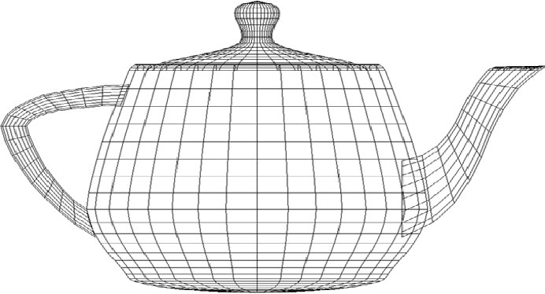
Rendering with Lines
must draw in both directions
for(j=0;j<100;j++) {
glBegin(GL_LINE_STRIP);
for(i=0;i<100;i++)
glEvalCoord2f((float) i/100.0, (float) j/100.0);
glEnd();
glBegin(GL_LINE_STRIP);
for(i=0;i<100;i++)
glEvalCoord2f((float) j/100.0, (float) i/100.0);
glEnd();
}
Angel: Interactive Computer Graphics 5E © Addison-Wesley 2009

Slide 13
Rendering with Quadrilaterals
We can form a quad mesh and render with lines
for(j=0; j<99; j++) {
glBegin(GL_QUAD_STRIP);
for(i=0; i<100; i++) {
glEvalCoord2f ((float) i/100.0,
(float) j/100.0);
glEvalCoord2f ((float)(i+1)/100.0,
(float)j/100.0);
}
glEnd():
}
Angel: Interactive Computer Graphics 5E © Addison-Wesley 2009

Slide 14
Uniform Meshes
We can form a 2D mesh (grid) in a similar manner to 1D for uniform spacing
  glMapGrid2(u_num, u_min, u_max, v_num, v_min, v_max)
Can evaluate as before with lines or if want filled polygons
  glEvalMesh2( GL_FILL, u_start, u_num, v_start, v_num)
Angel: Interactive Computer Graphics 5E © Addison-Wesley 2009

Slide 15

Rendering with Lighting
If we use filled polygons, we have to shade or we will see solid color uniform rendering
Can specify lights and materials but we need normals
  Let OpenGL find them
  glEnable(GL_AUTO_NORMAL);
Angel: Interactive Computer Graphics 5E © Addison-Wesley 2009

Slide 16
NURBS
OpenGL supports NURBS surfaces through the GLU library
Why GLU?
  Can use evaluators in 4D with standard OpenGL library
  However, there are many complexities with NURBS that need a lot of code
  There are five NURBS surface functions plus functions for trimming curves that can remove pieces of a NURBS surface
Angel: Interactive Computer Graphics 5E © Addison-Wesley 2009

Slide 17
Quadrics
Quadrics are in both the GLU and GLUT libraries
  Both use polygonal approximations where the application specifies the resolution
  Sphere: lines of longitude and lattitude
GLU: disks, cylinders, spheres
  Can apply transformations to scale, orient, and position
GLUT: Platonic solids, torus, Utah teapot, cone
Angel: Interactive Computer Graphics 5E © Addison-Wesley 2009

Slide 18
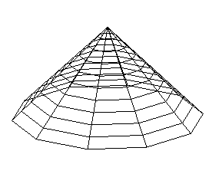
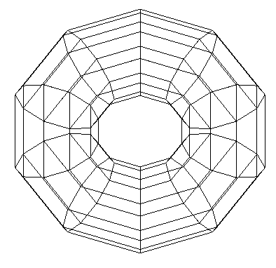
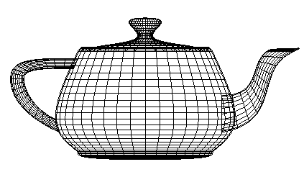
GLUT Objects
Each has a wire and a solid form
glutWireCone()
glutWireTorus()
glutWireTeapot()
Angel: Interactive Computer Graphics 5E © Addison-Wesley 2009

Slide 19
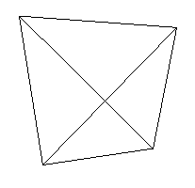
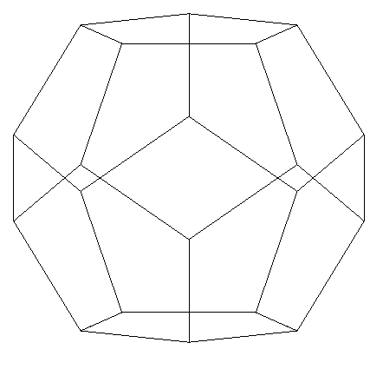
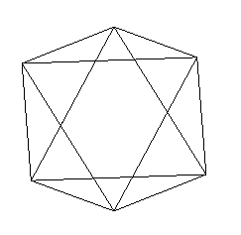
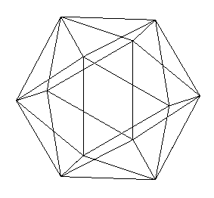
GLUT Platonic Solids
glutWireTetrahedron()
glutWireDodecahedron()
glutWireOctahedron()
glutWireIcosahedron()
Angel: Interactive Computer Graphics 5E © Addison-Wesley 2009

Slide 20
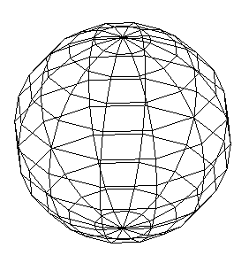
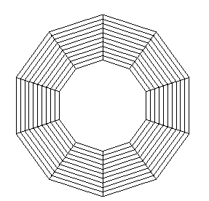
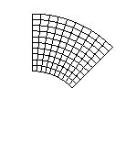
Quadric Objects in GLU
GLU can automatically generate normals and texture coordinates
Quadrics are objects that include properties such as how we would like the object to be rendered
partial disk
disk
sphere
Angel: Interactive Computer Graphics 5E © Addison-Wesley 2009

Slide 21
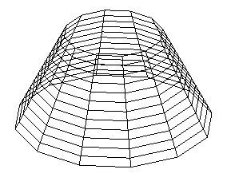
Defining a Cylinder
GLUquadricOBJ *p;
P = gluNewQuadric(); /*set up object */
gluQuadricDrawStyle(GLU_LINE);/*render style*/
gluCylinder(p, BASE_RADIUS, TOP_RADIUS,
BASE_HEIGHT, sections, slices);
Angel: Interactive Computer Graphics 5E © Addison-Wesley 2009

